Slide 1
Flower Image Classifier
Sanat, Ese, Hemanth

Slide 2
Introduction
There are different kinds of flower species and through the use of labelled image dataset, we seek to classify flower images into classes of different species.

Slide 3

Use Case
Research in Botanical studies
As there large no. of flower species, an image classifier of flowers is extremely useful in their studies and finding new flower species

Slide 4
Scope
Supervised deep learning classification task
Develop a model to classify flower images into 102 different species

Slide 5
Features
Data Augmentation
Transfer learning from a pre-trained model (ResNet 152) for feature extraction
Convolutional Neural Network (CNN) using PyTorch

Slide 6
Data Source
Automated flower classification over a large number of classes: Proceedings of the Indian Conference on Computer Vision, Graphics and Image Processing (2008)
http://www.robots.ox.ac.uk/~vgg/data/flowers/102/
102 flower categories. Each class consists of between 30 to 158 images.
Training and validation dataset contains 6552 images
Testing dataset consists 2860 images

Slide 7
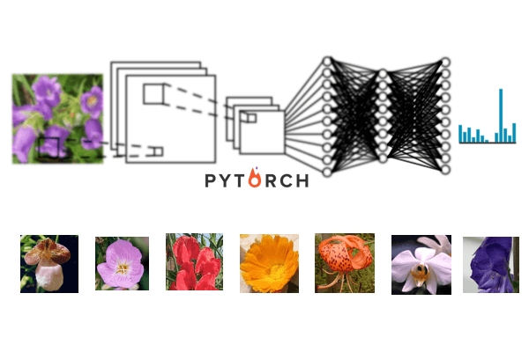
How CNN Works

Slide 8




AWS Cloud Services
Amazon SageMaker
Amazon S3
AWS Identity and Access Management
Amazon CloudWatch

Slide 9
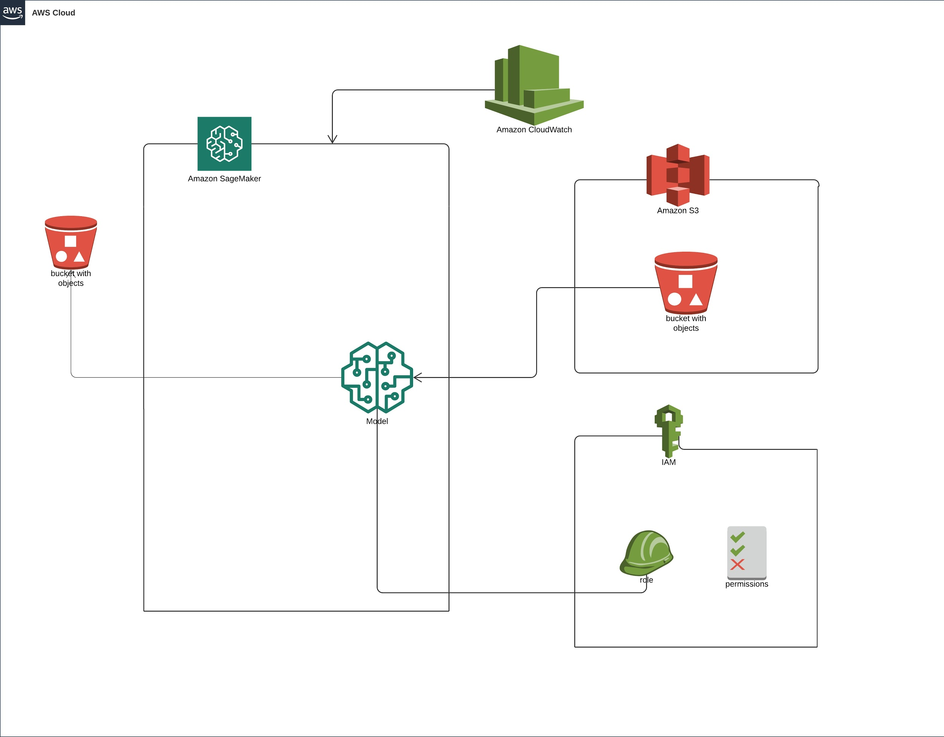
Architecture

Slide 10
Training Parameters
Parameter | Value
Pre-trained Model | ResNet 152
Fully Connected Layer I | 2048 x 512
Fully Connected Layer II | 512 x 102
Activation Function | ReLU
Dropout | 0.25
ML Instance (Compute) | ml.p2.xlarge
Learning Rate | 0.01
Deep Learning Framework | PyTorch

Slide 11
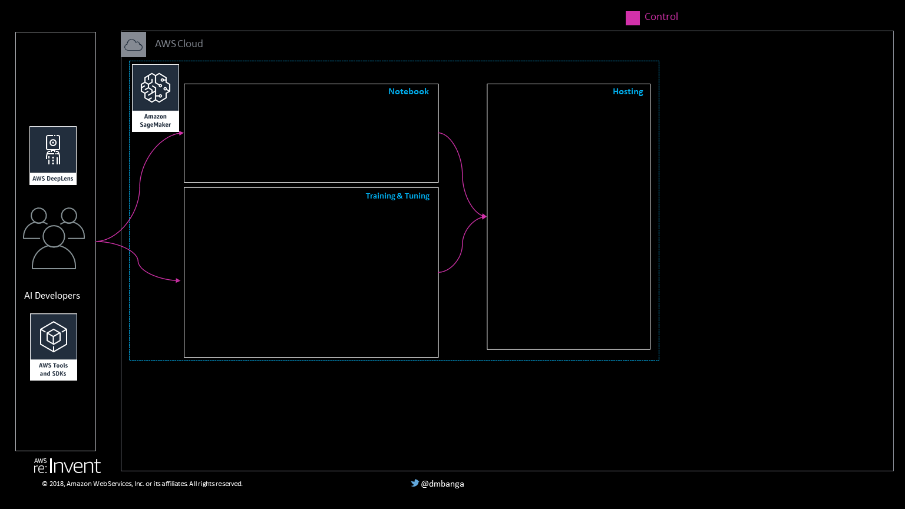
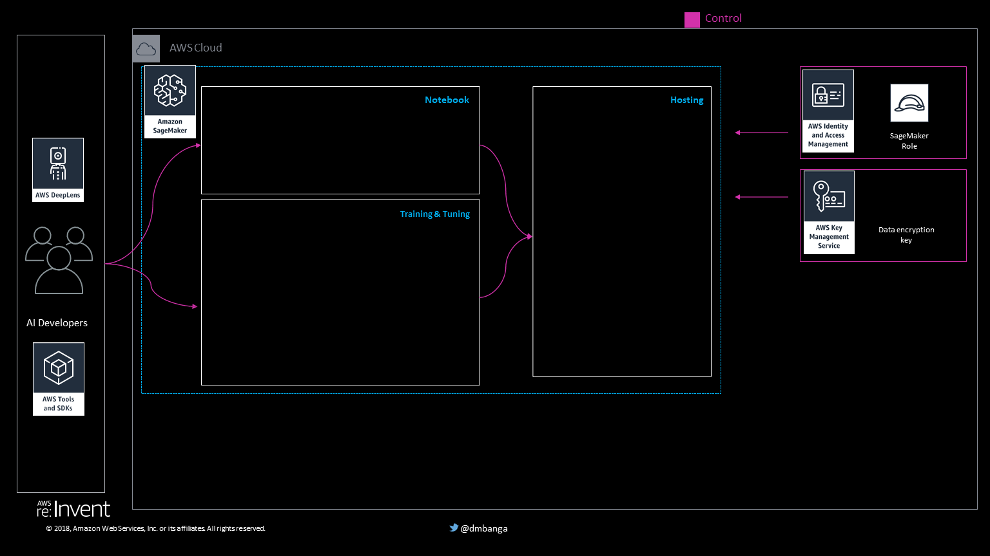
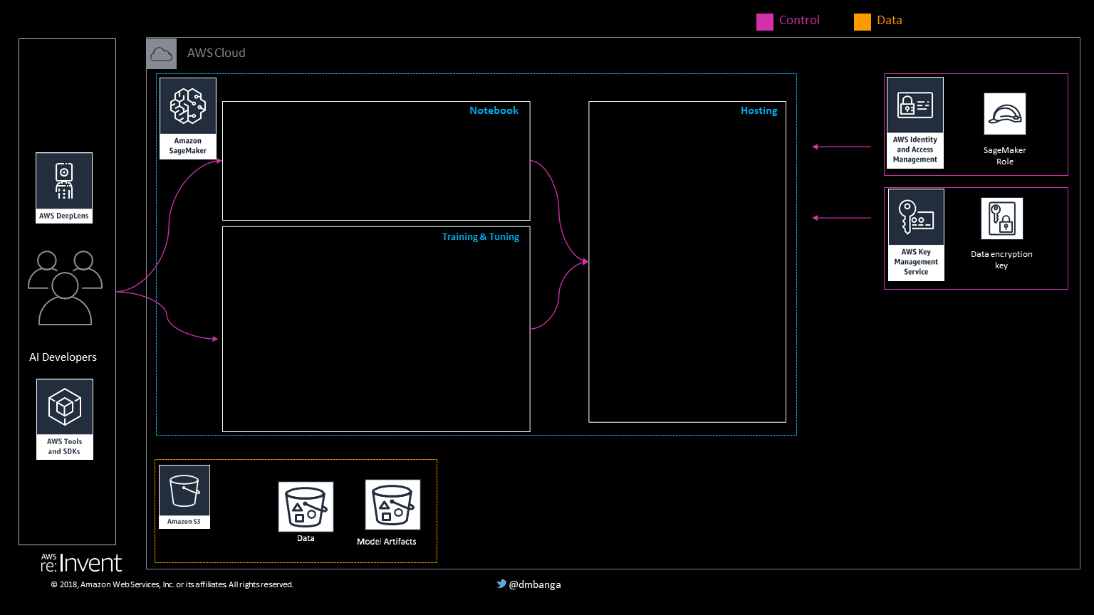
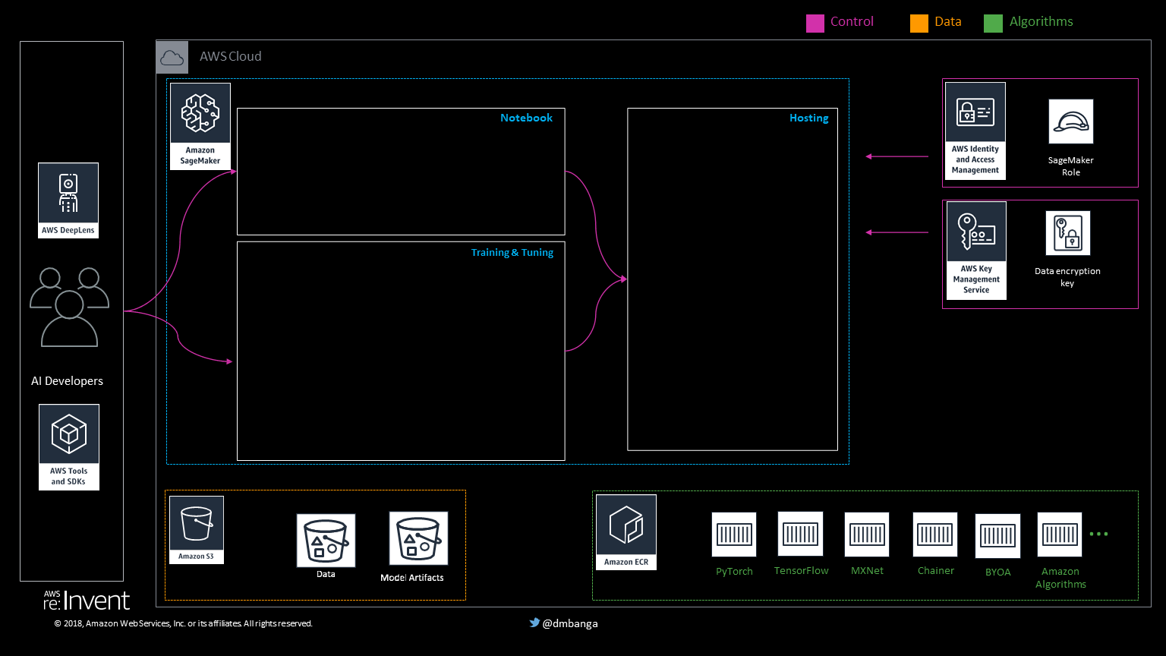
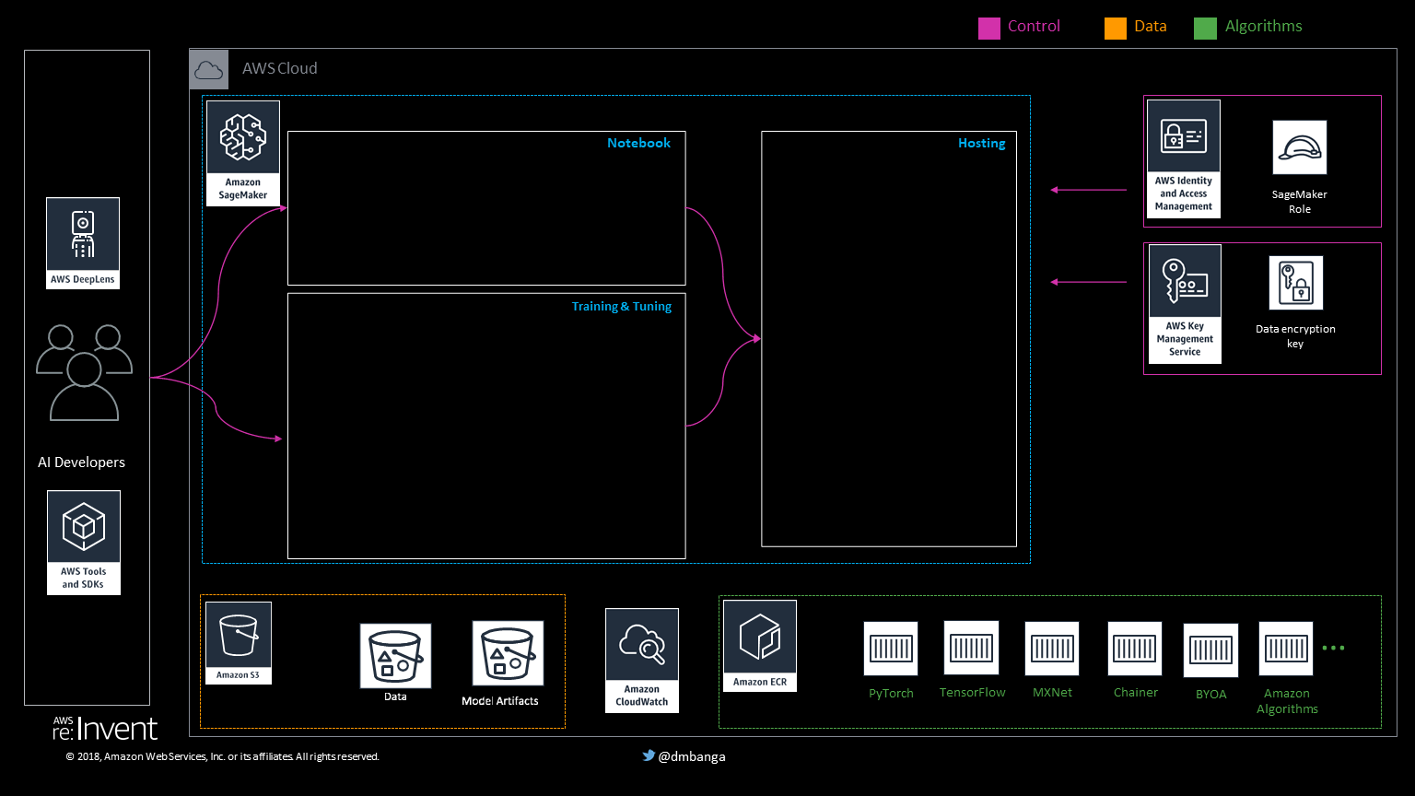
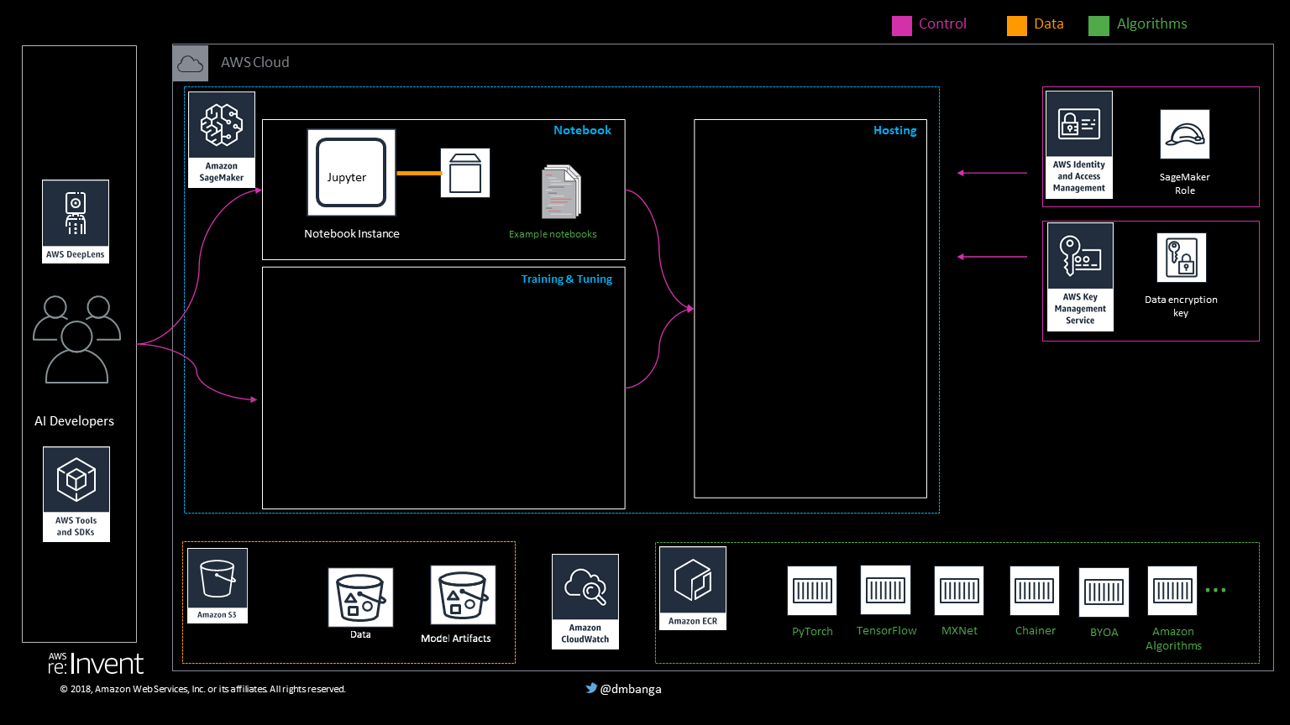
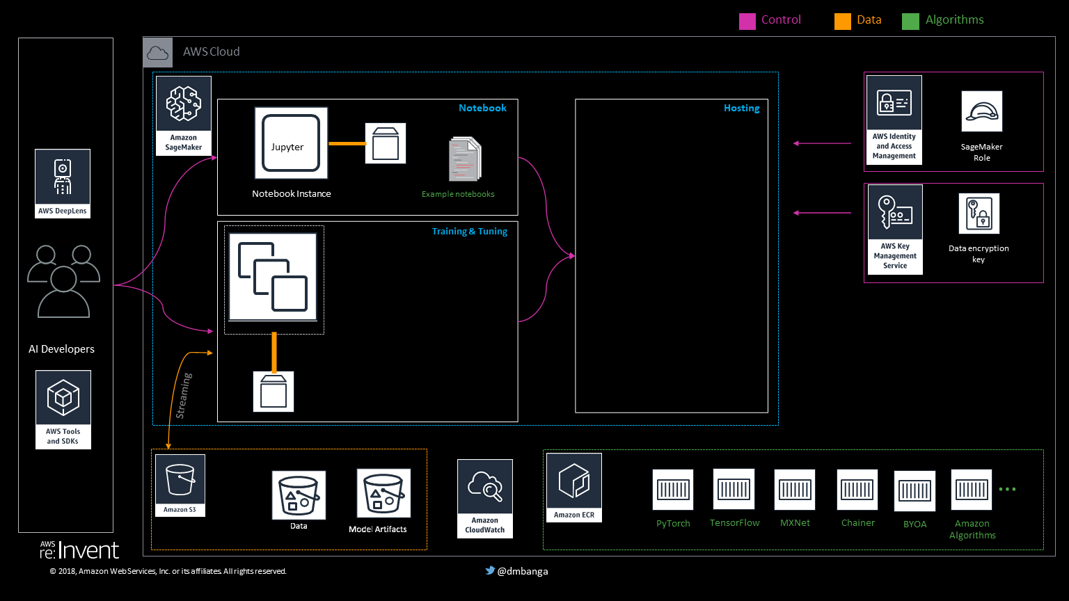
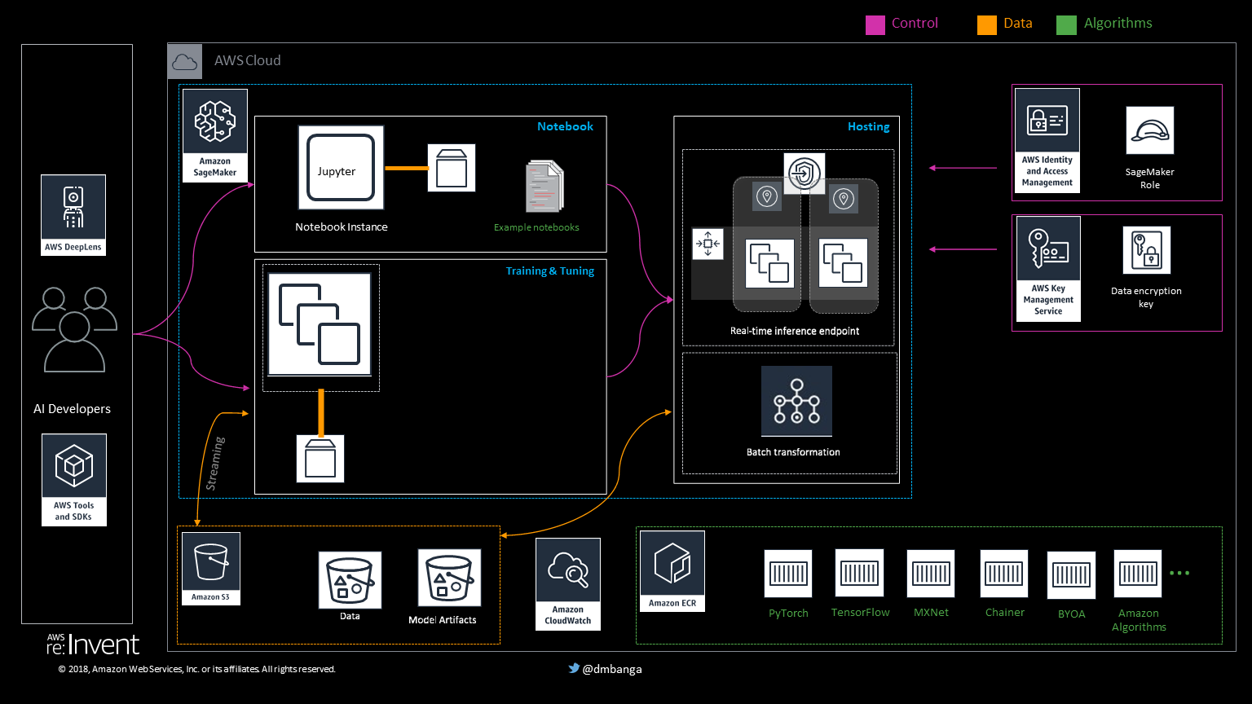
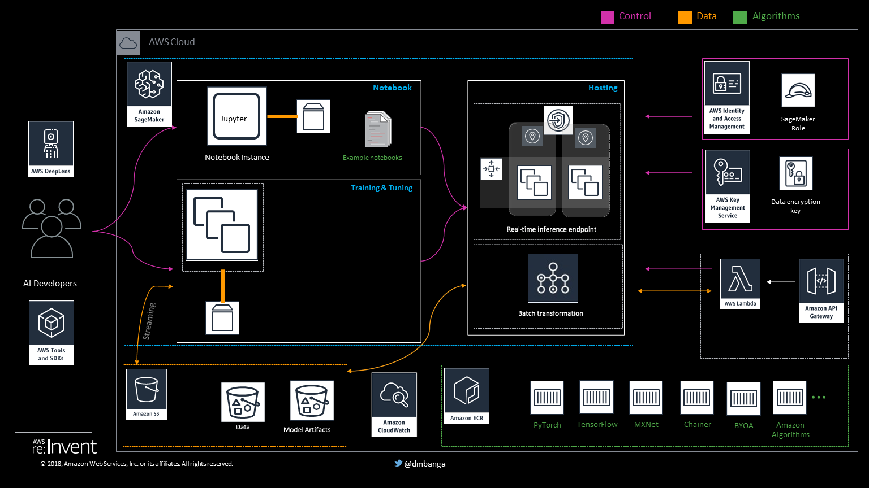
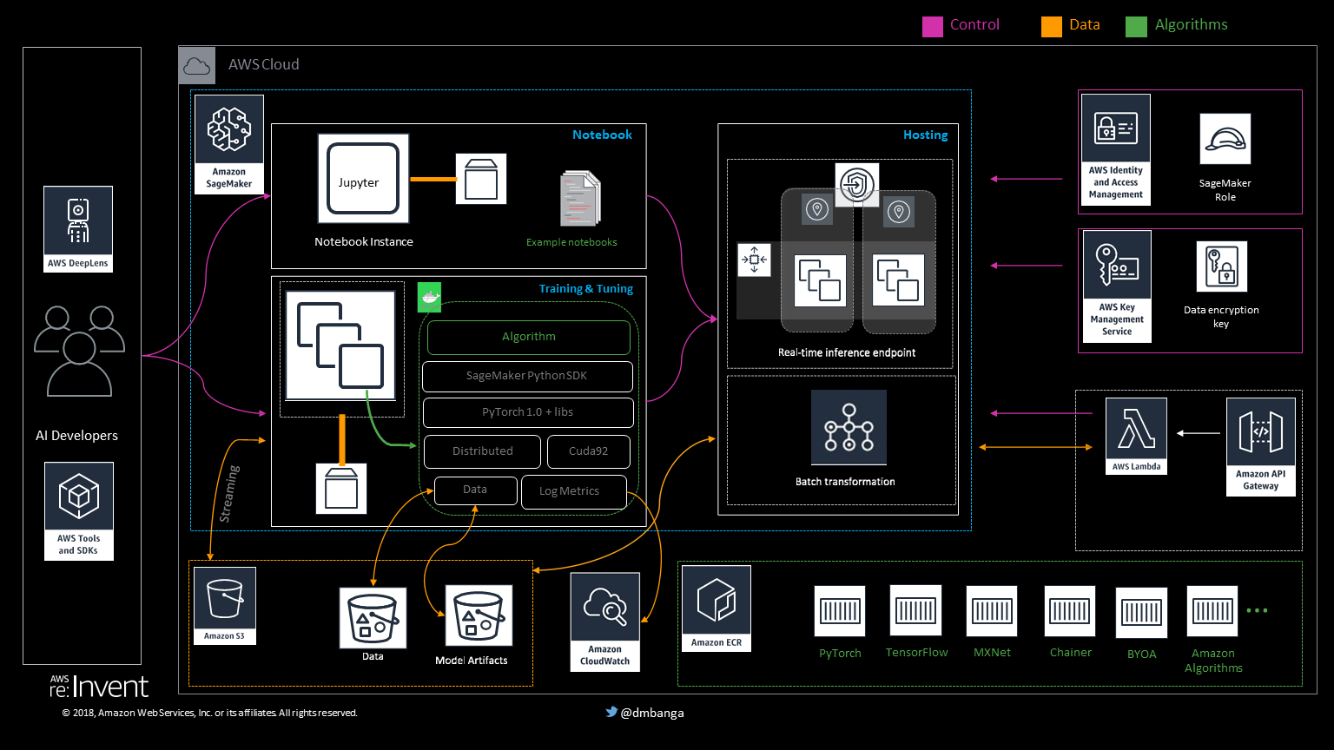

Logical Structure of Sagemaker

Slide 12
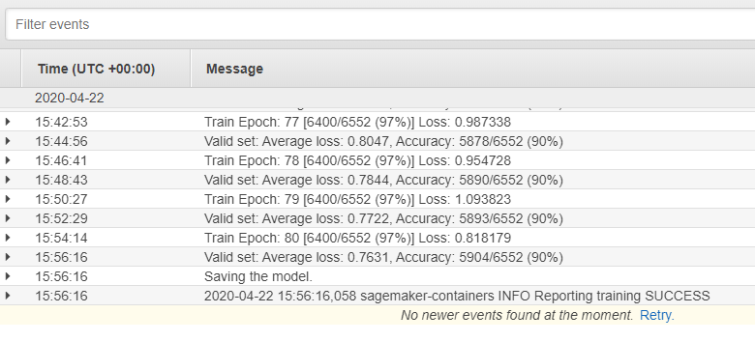
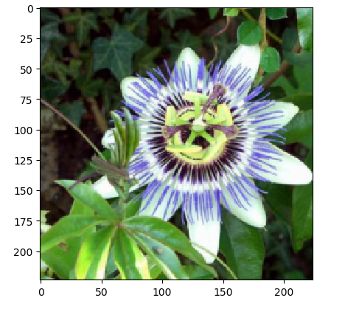
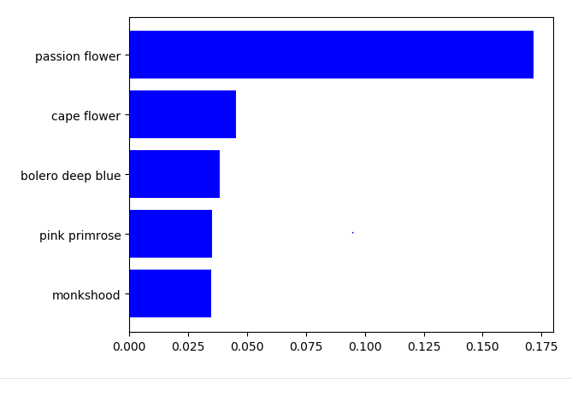
Results
Parameter | Value
Duration of training | 5 hours
No. of epochs | 80
Accuracy | 90%

Slide 13
Demo

Slide 14
Thank You

